Slide 1
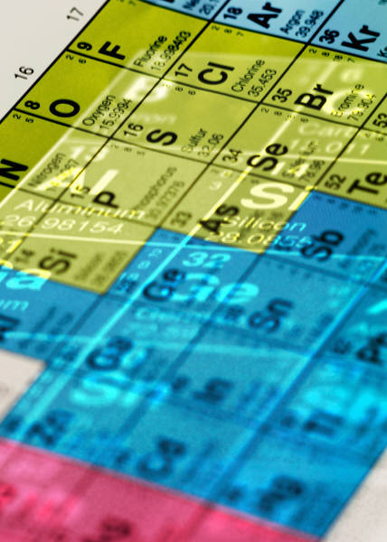
Element Symbols

Slide 2
Hydrogen Helium
Lithium Beryllium
Boron Carbon
Nitrogen Neon
Fluorine Uranium
Sodium Radon
Aluminum Gold
Phosphorus Lead

Slide 3
Chlorine Magnesium
Potassium Tungsten
Titanium Cesium
Manganese Silicon
Cobalt Sulfur
Copper Argon
Arsenic Iodine
Bromine Cadmium

Slide 4
Rubidium Strontium
Silver Krypton
Tin Selenium
Xenon Zinc
Barium Nickel
Platinum Iron
Mercury Chromium
Bismuth Calcium
Radium Oxygen
Antimony

